Slide 1
Valuing Diversity
Beth A. Cunningham
Executive Officer
American Association of Physics Teachers
(presentation to Einstein Fellows on March 24, 2015)
Notes:
AAPT has as one of the four goals in the 2013 Strategic Plan “Enrich the field by increasing the number and diversity of physics students and teachers at all levels, including those from ethnic and linguistically diverse backgrounds, those with diverse abilities, and those from the LGBT+ community.”

Slide 2
Session Objectives
As a result of this session, participants will:
Become familiar with implicit bias and stereotype threat
Be able to identify potential sources of bias in the classroom
Be able to develop strategies to minimize bias

Slide 3
Identity
Please take a few minutes to reflect upon the most important aspects of your own identity.
Make a list of the aspects of your identity you feel are most important. (You do not have to share this.)

Slide 4
HERStories video

Slide 5
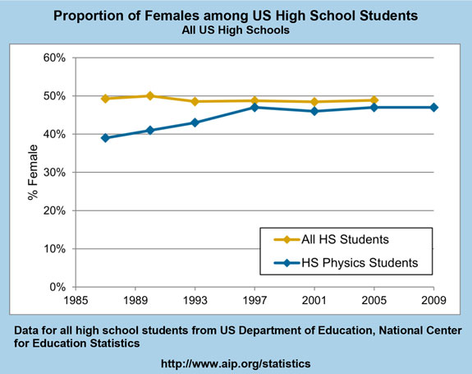

Slide 6
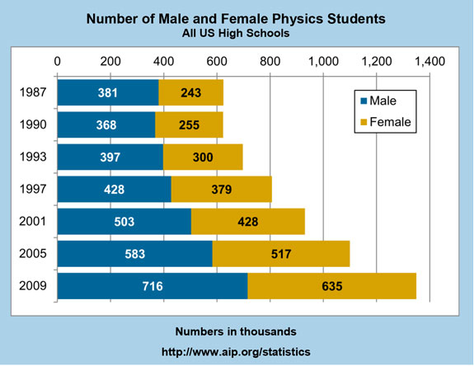

Slide 7
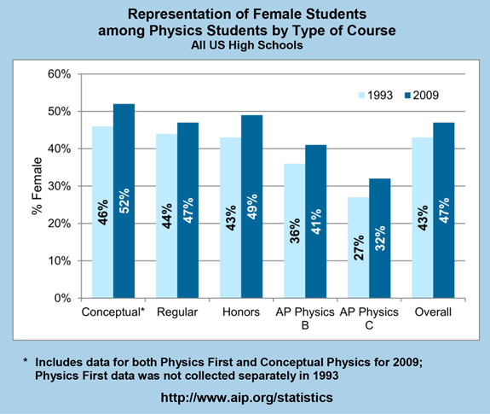

Slide 8
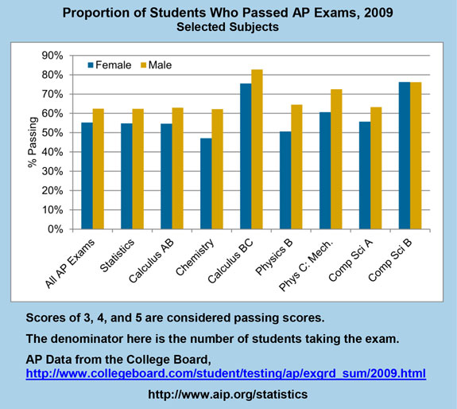

Slide 9
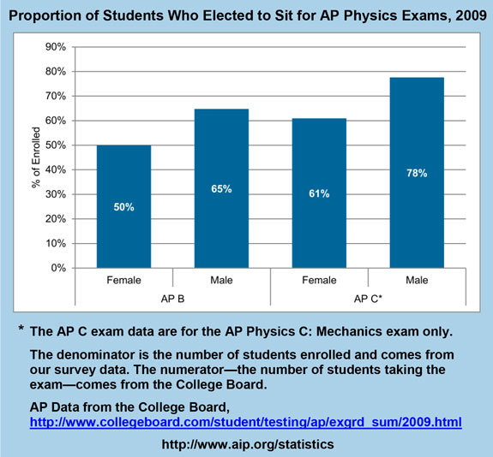

Slide 10
Sex Composition in High Schools
Notes:
The representation of women among HS physics teachers has been growing. It was 23% in 1987 and 30% in 2005.

Slide 11
Implicit Aptitude Tests
Share your reflections on the IAT and discuss how this information informs your identity as a scientist and educator.

Slide 12
Implicit Bias and Stereotype Threat
What is implicit bias?
What is stereotype threat?
Notes:
Implicit bias refers to the attitudes or stereotypes that affect our understanding, actions, and decisions in an unconscious manner. These biases, which encompass both favorable and unfavorable assessments, are activated involuntarily and without an individual’s awareness or intentional control.
Stereotype threat is a situational predicament in which people are or feel themselves to be at risk of confirming negative stereotypes about their social group.

Slide 13
A Few Characteristics About Implicit Bias
Implicit biases are pervasive.
Implicit and explicit biases are related but distinct mental constructs.
The implicit associations we hold do not necessarily align with our declared beliefs or even reflect stances we would explicitly endorse.
We generally tend to hold implicit biases that favor our own in-group.
Implicit biases are malleable.

Slide 14
Consequences of Stereotype Threat
Decreased performance
Internal attributions for failure
Self-handicapping
Task discounting
Distancing the self from the stereotyped group
Disengagement and dis-identification
Altered professional identities and aspirations

Slide 15
Instructional Interventions for the Classroom
To reduce gender (and racial) achievement gaps:
Interactive methods such as peer instruction and curricular materials such as tutorials in introductory physics and context-rich problems
Restructuring an entire course
Introducing mentoring

Slide 16
Unique Intervention for Stereotype Threat (Miyake et al, Science 330, 1234 (2010))
Fear of being devalued based on identity (social-psychological and cognitive)
Values affirmation – people reflect on self-defining values
Intervention involves writing about personally important values (such as friends and family): 15 minutes – select most important value from list and write why those values were important
Given twice (first recitation in week 1, online homework in week 4)
Notes:
Physics Education Research (PER) = their home is AAPT. Co-author of this paper is active AAPT member.
Study performed at CU Boulder – introductory physics course – students who already indicated interest in STEM (well prepared), high achieving, more-advantaged backgrounds
Control group = selected least important values and wrote why those values might be important to other people.

Slide 17
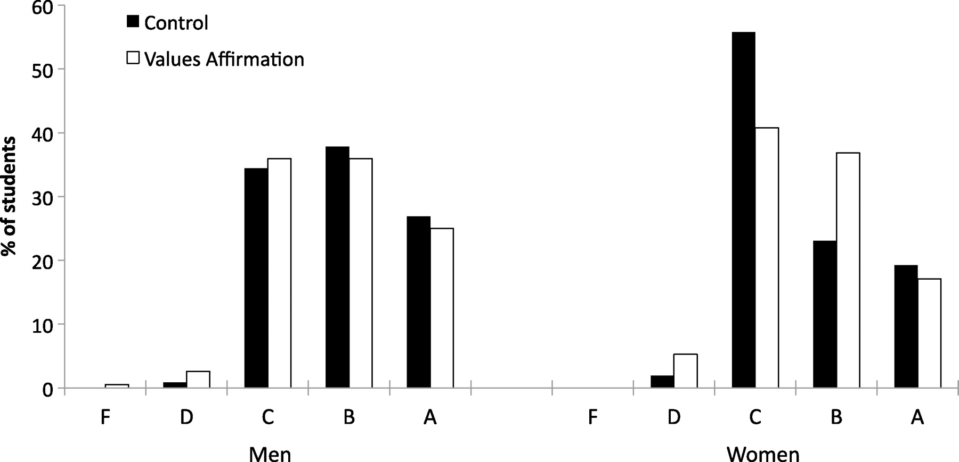
Fig. 2 Percentage of students receiving each letter grade (A, B, C, D, and F, combining letter grades with pluses and minuses) as a function of gender (men versus women) and affirmation condition (values affirmation versus control).
Akira Miyake et al. Science 2010;330:1234-1237
Published by AAAS
Notes:
Percentage of students receiving each letter grade (A, B, C, D, and F, combining letter grades with pluses and minuses) as a function of gender (men versus women) and affirmation condition (values affirmation versus control). The percentage was calculated separately for each values-affirmation condition within each gender.

Slide 18
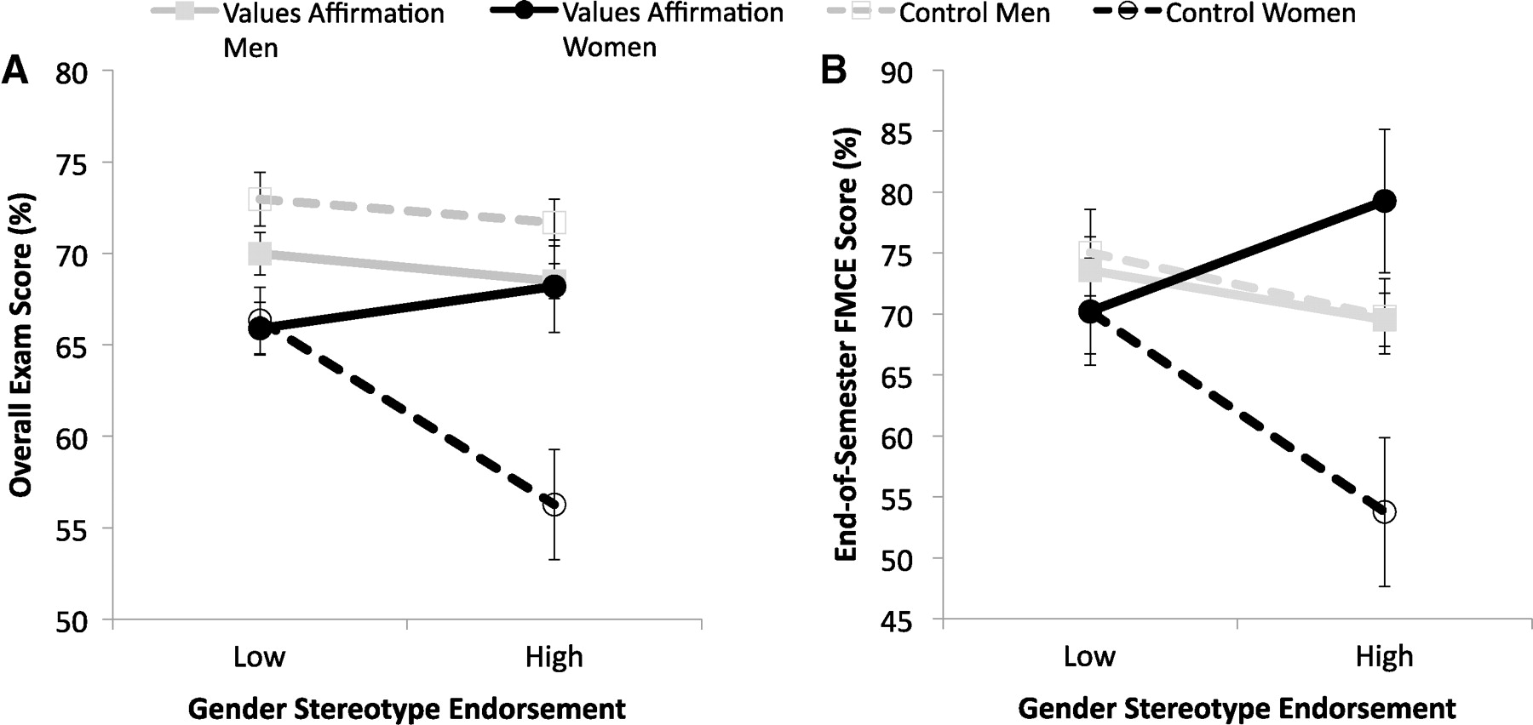
Fig. 3 Student performance on two outcome measures examined in this study as a function of gender (men versus women), affirmation condition (values affirmation versus control), and the level of stereotype endorsement.
Akira Miyake et al. Science 2010;330:1234-1237
Published by AAAS
Notes:
Student performance on two outcome measures examined in this study as a function of gender (men versus women), affirmation condition (values affirmation versus control), and the level of stereotype endorsement. (A) The overall combined exam scores, computed by averaging the percentage scores for the four exams. (B) The end-of-semester (week 15) score on the FMCE, a standardized test of conceptual knowledge in physics (33). Stereotype endorsement, treated as a continuous variable in our statistical analysis, was measured by agreement with the statement, “According to my own personal beliefs, I expect men to generally do better in physics than women,” answered on a five-point scale ranging from “strongly disagree” to “strongly agree.” The level of stereotype endorsement plotted in the graph was standardized for all students and expressed in terms of z scores (20). The low and high levels of stereotype endorsement in the graph are represented by ±0.75 SD of the grand mean (SOM text). Error bars represent ±1 SE.

Slide 19
Brainstorm!
What strategies might you use in the classroom setting to address implicit bias and stereotype threat?

Slide 20
Thank You!
See aapt.org for information about AAPT’s programs and projects addressing diversity and inclusion in physics education
Resources
The Physics Teacher
eMentoring
AAPT national conferences

